Slide 1
Air Canvas and Virtual Computer System
Darshan Patel 118A1020
Kriti Kakkar 118A1032
Harshitha Moolya 118A1048
Project Guide: Prof. Masooda Modak

Slide 2
Presentation outline
Introduction
Related Work
Proposed System(with objectives)
Methodology
Results
Conclusion
Publications
References

Slide 3
Introduction
In the era of the digital world, traditional art of writing is being replaced by digital art. Digital art refers to forms of expression and transmission of art in digital form.
Air Canvas is a hands-free digital drawing tool that uses a technique of AI based components like OpenCV to draw and perform different functionalities on the screen using hand gestures.
In our project, we have implemented mouse control events, keyboard control using a hand gesture recognition. It's a system that performs image processing, retrieves needed details, and then adds them to the computer's mouse and keyboard interface using predefined notations.
Our aim is to develop a full-fledged app which operates without peripheral input devices.

Slide 4
Literature Survey
Sr. No | Title of the paper | Conference/Year | Purpose/Key Findings | Gaps/Issues
1 | AIR CANVAS APPLICATION USING OPENCV AND NUMPY IN PYTHON | August 08, 2021 | This project is a reporter of occasional gestures. It used computer vision to trace the path of the finger. The generated text was used for various purposes, such as sending messages, emails, etc. It will be a powerful means of communication for the deaf. It is an effective communication method that reduces mobile and laptop usage by eliminating the need to write. | Use of character Recognition is time consuming and Complex
2 | Text Writing in Air | 2013 | The system proposed consists of following steps. It tracks the motion of colored finger tip, find its coordinates and plot the coordinates. After plotting coordinates optical character reorganization (OCR) is applied on plotted image, the output is matched with trained database for OCR and the most possible match is achieved and displayed. | The system proposed is color sensitive in such a way that existence of any red color in the background before starting the analysis can lead to false results.

Slide 5
Literature Survey
Sr. No | Title of the paper | Conference/Year | Purpose/Key Findings | Gaps/Issues
3 | An Implementation of Virtual Reality Application of Cursor Control Using Webcam | September, 2016 | The code uses a well known library for image processing, known as, openCV in the form of emguCV which is a .NET wrapper of it. First of all the application tries to catch a video input device. If it is successful in doing so, it calls the function ProcessFramAndUpdateGUI() where all the processing is done | System can’t fully eliminate the need of mouse and keyboard completely. This work aims to build an interactive computer system which can be operated without any physical mouse and keyboard
4 | An Interactive Computer System with Gesture-Based Mouse and Keyboard | February, 2020 | The aim of this paper is to implement a computer application which uses alternative methods to control keyboard and mouse cursors for rehabilitation of people who are suffered from stroke so that they can recover the side effects | May perform less accurately in a low light condition.Moreover, the work can be extended for a wide variety of environments and can be tested using the sophisticated existing models

Slide 6
Literature Survey
Sr. No | Title of the paper | Conference/Year | Purpose/Key Findings | Gaps/Issues
5 | A Camera Based Virtual Keyboard with Touch Detection by Shadow Analysis | December 10, 2013 | In this system, a webcam looks down on a user's hands, which rests on a paper keyboard template. The program collects images from the webcam to determine when and where the user touches the keyboard template. When the user touches a key, the program produces the corresponding letter as output. | Difficulties in fingertip identification.The system does not deliver dependable performance when two fingers are merged into a single region or when one finger occludes another.
6 | Virtual Keyboard | April-2014 | The implementation is done with the use of DIP . A projector is used for projecting the image of a keyboard and camera was used for image acquisition purposes. Processor is used to process the image captured by the camera. The purpose of a .NET platform software was frame extraction. | This implementation supports only single touch.

Slide 7
Proposed System
Proposed System:
The aim of this project is to develop an AI based tool(Air Canvas) using techniques of OpenCV which can draw anything on a screen by just capturing the motion of a finger or virtual pen with a webcam, and to build a virtual computer system that uses hand gestures to perform various functions
Objectives:
To create a virtual canvas to sketch, perform morphological operations and to also include different types of shapes so that the user can directly use them by picking and dragging them virtually.
To implement Virtual Keyboard.
To include Virtual Mouse system.
To develop a full-pledge app in order to make use of this amazing tool.
.

Slide 8
Methodology
Methodology For Air Canvas:
Air Canvas is a digitally advanced drawing tool which OpenCV algorithms to draw and write on a digital canvas board.
In order to achieve the goal, hand detection and tracking is done.
We have also given various features like options for drawing with pen and an eraser to erase the drawn content and.
We have also implemented additional components like shapes to enable user to draw shapes with drag and drop gesture.

Slide 9
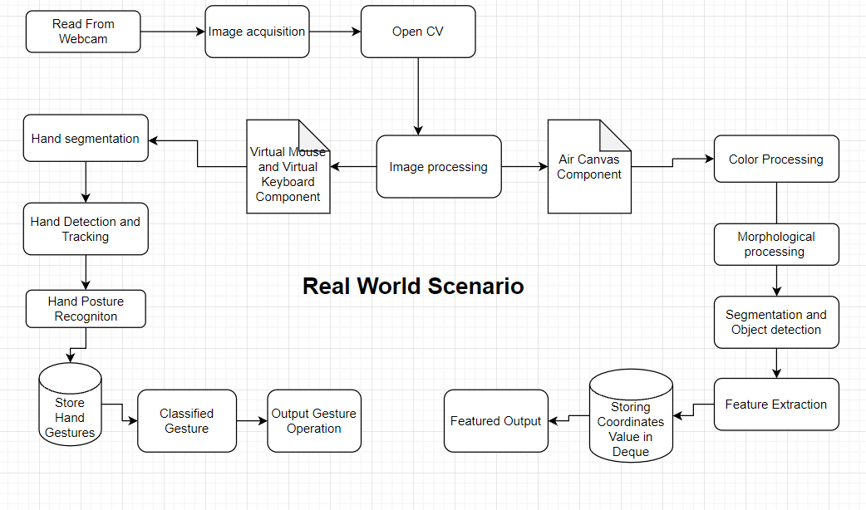

Slide 10
Methodology
Methodology For Virtual Computer System
The camera will start taking the input from webcam.
Using the hand detection module of OpenCV library,we will track the hands.It will also track the landmarks on hands.
The characters are displayed on the screen as buttons.
If the distance between the fingers is less than a specific distance then click operation will be performed.
The text will be displayed wherever the cursor is pointed in the screen.

Slide 11
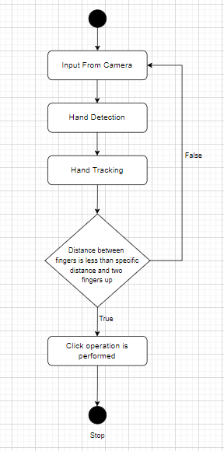
Flow Chart Of Virtual keyboard System

Slide 12
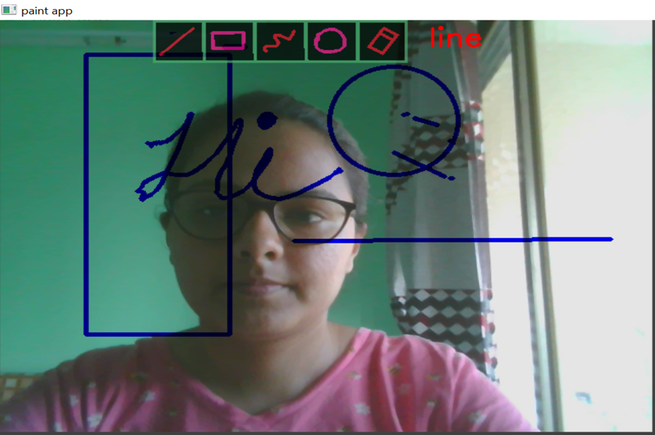
Results
The Figure shown alongside demonstrates our air canvas project with a sample virtual sketch displayed on the output screen.
It has features like different color options for sketching virtually, along with eraser and shapes option.

Slide 13
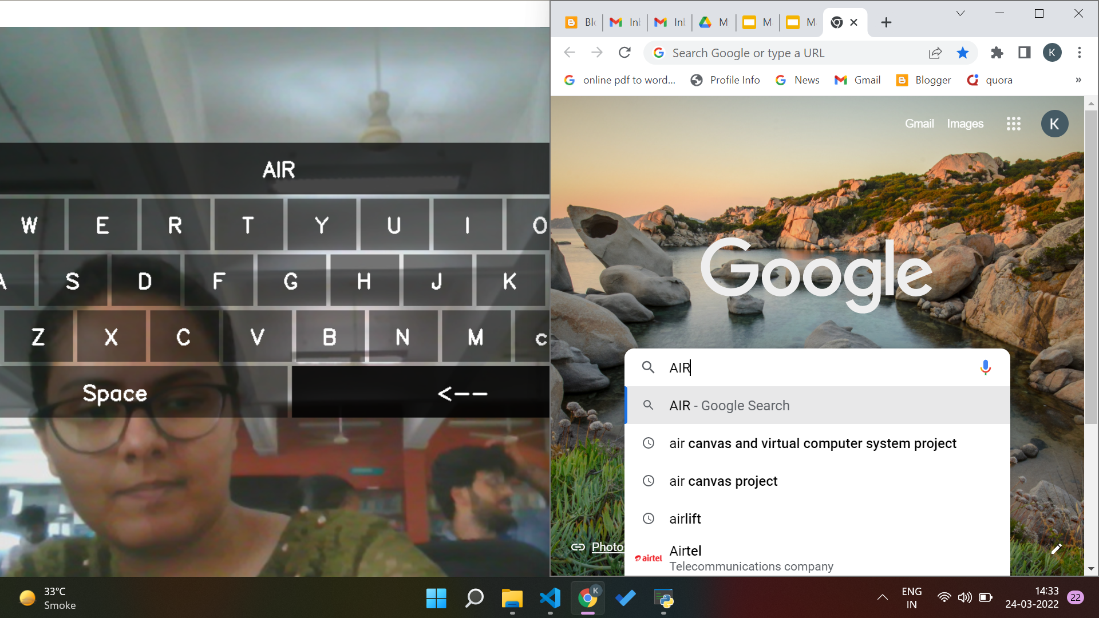
The figure shown above demonstrates our Virtual Keyboard system. Using Hand Gesture Recognition technique and various other algorithms of our system, when we perform hand gesture movement in front of screen, the action is performed accordingly and we are able to write in the browser virtually.

Slide 14
Conclusion
The coming era is of smart tech where tools like Air Canvas and Virtual Computer Systems holds high potential to replace and overcome the inefficiency and loopholes of conventional systems.
This will not only save space and time but also improve human-machine interaction and bring better quality of life. The evolution can be as big as making the devices user friendly even for the disabled.
In this System, we devised a digital computer application inclusive of mouse and keyboard manipulation together with a digital art tool as Air Canvas.
But, there continues to be a scope of improvement for and need of efficiency, in addition to a few high-quality features.

Slide 15
Publications
We have presented our research and implementation at the International Conference on Trends in Engineering, Applied Science and Management (IC- TEAM) under the Information and Communication Technology track.

Slide 16
References
Saoji, S. U., et al. "AIR CANVAS APPLICATION USING OPENCV AND NUMPY IN PYTHON." (2021).
Baig, Faisal, Muhammad Fahad Khan, and Saira Beg. "Text writing in the air." Journal of Information Display 14.4 (2013): 137-148.
Jain, Ayush, and Monika Verma. "An Implementation of Virtual Reality Application of Cursor Control Using Webcam.
Gupta, Dipankar, et al. "An Interactive Computer System with Gesture-Based Mouse and Keyboard." International Conference on Intelligent Computing & Optimization. Springer, Cham, 2020.
Thomas, Joseph. "A Camera Based Virtual Keyboard with Touch Detection by Shadow Analysis.’ (2013).
Nikhil Koul Pranav Nawathe Pranav Tulpule “Virtual Keyboard” International Journal of Scientific & Engineering Research, Volume 5, Issue 4, April-2014 650 ISSN 2229-5518
Pranavi Srungavarapu, Eswar Pavan Maganti, Srilekkha Sakhamuri, Sai Pavan Kalyan Veerada, Anuradha Chinta “Virtual Sketch using Open CV” International Journal of Innovative Technology and Exploring Engineering (IJITEE) ISSN: 2278-3075 (Online), Volume-10 Issue-8, June 2021
Chetan Chilhate, Priyanka D Patharwat, Shriyanka Agarwal, Vivek, Prof. Gauri. S. Bhange “Human Computer Interface Based Virtual Mouse” Vol-3 Issue-2 2017 IJARIIE-ISSN(O)-2395-4396

